Slide 1
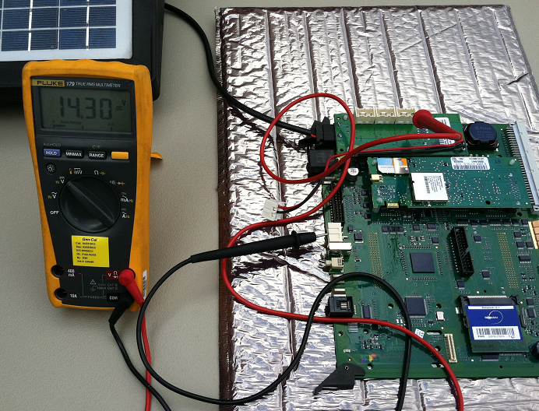
Strada TPAL charging voltage check
With a digital voltage meter you may check the charging voltage going to the battery from the 3 battery interface board.

Slide 2
Strada TPAL charging voltage check
The voltage check may be done with the main board still in the strada pay station. You will need to slide the main board out to reach the 3 battery interface board.
Be sure to turn off the power when disconnecting the main board.
3 battery interface board.

Slide 3
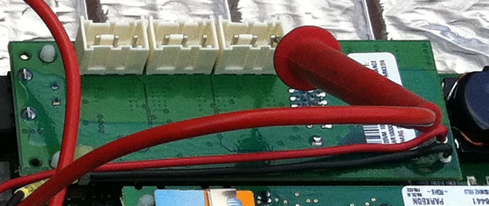
Strada TPAL charging voltage check
Disconnect all of the batteries from the connector board

Slide 4
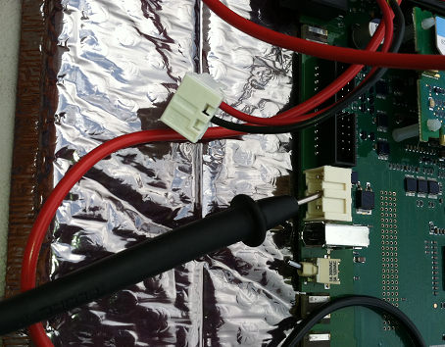
Strada TPAL charging voltage check
Disconnect the battery board connector on the main board

Slide 5
Strada TPAL charging voltage check
Connect the negative lead to the center pin of the battery board connector on the main board. Do not touch cross the connection to the positive pin. This may blow the main board fuse which is not field replaceable.

Slide 6
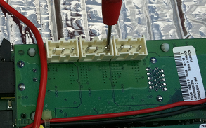
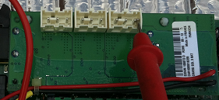
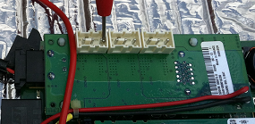
Strada TPAL charging voltage check
Check the voltage at all three connections

Slide 7
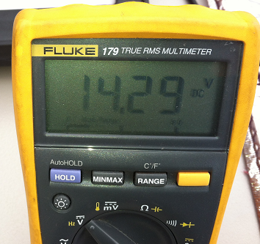
Strada TPAL charging voltage check
The voltage should be 13.5 volts or higher.

