Slide 1
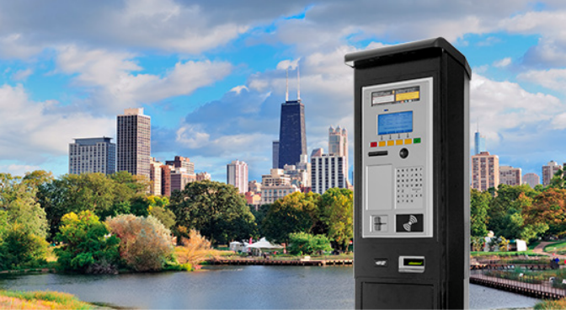
CWT Compact Hands On

Slide 2
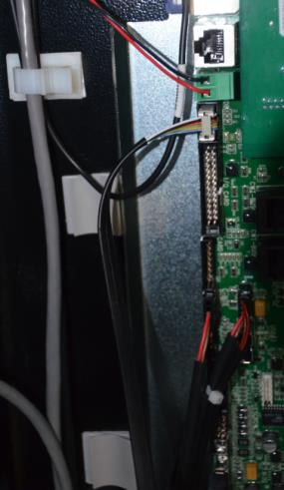
CWT Compact – Bill Acceptor (BA) Removal
Unplug and release BA cable from the main board

Slide 3
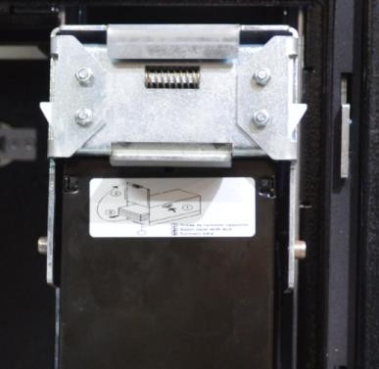
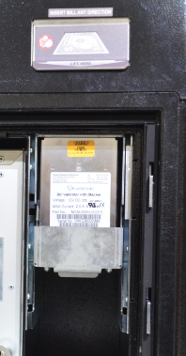
CWT Compact – Bill Acceptor (BA) Removal
Inside the lower vault.
Pull on latch to release BA locks. Pull out and up

Slide 4
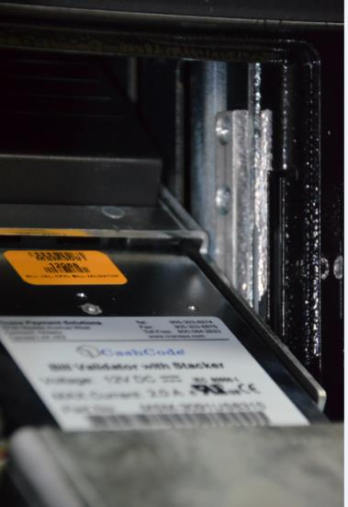
CWT Compact – Bill Acceptor (BA) Removal
With BA in this position, the 2 philips screws can be removed to remove the safety plate.
With the plate removed, lift the BA up to a level position and then pull out.
Gently feed the BA cable down from the top to prevent damage.

Slide 5
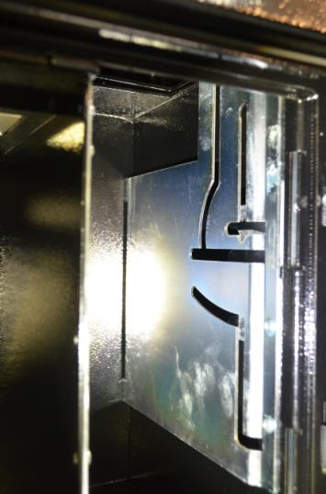
CWT Compact – Bill Acceptor (BA) Removal
Bill Acceptor Guide Plate

Slide 6
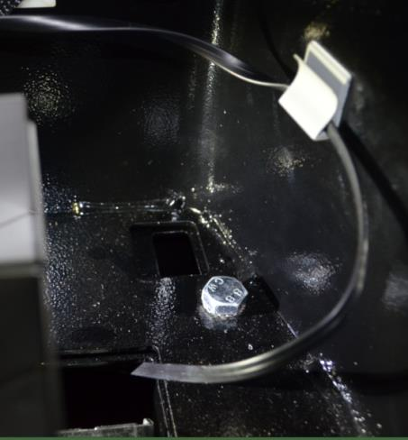
CWT Compact – Bill Acceptor (BA) Installation
Before installing the BA, route the data cable up through the cutout between the two cases. Do not fasten the cable in the clips at this time.

Slide 7
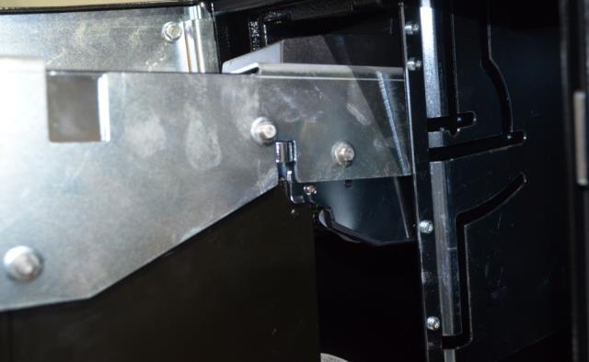
CWT Compact – Bill Acceptor (BA) Installation
With BA in this position, gently insert the unit into the guide plate making sure the correct guide pins are in the correct slots.

Slide 8
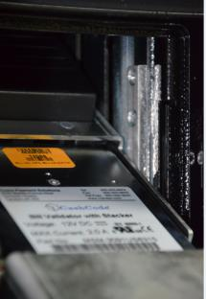
CWT Compact – Bill Acceptor (BA) Installation
With BA in this position, reinstall the 2 philips screws for the safety plate.
Rotate and push up on BA to return it to the locked position.

Slide 9
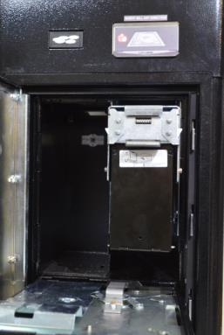
CWT Compact – Bill Acceptor (BA) Installation
Return the BA to the fully open position. Make sure nothing is binding and the cable moves freely.

Slide 10
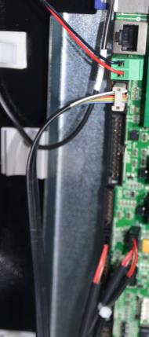
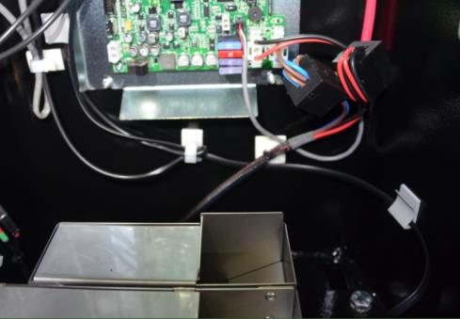
CWT Compact – Bill Acceptor (BA) Installation
Route the data cable into the right side keeper, under the main board and up the left side to the MDB plug on the main board.

Slide 11
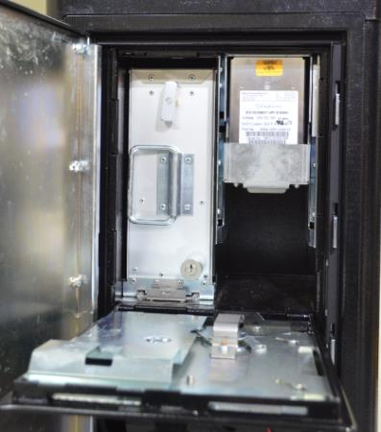
CWT Compact – Bill Acceptor (BA) Installation
Make sure the BA opens and closes without binding or pinching cables.
Return to the locked position and reinstall the coin box if previously removed.
Close and lock vault.

Slide 12
